Slide 1



UNIT 1
Look back 1
Part 2

Slide 2
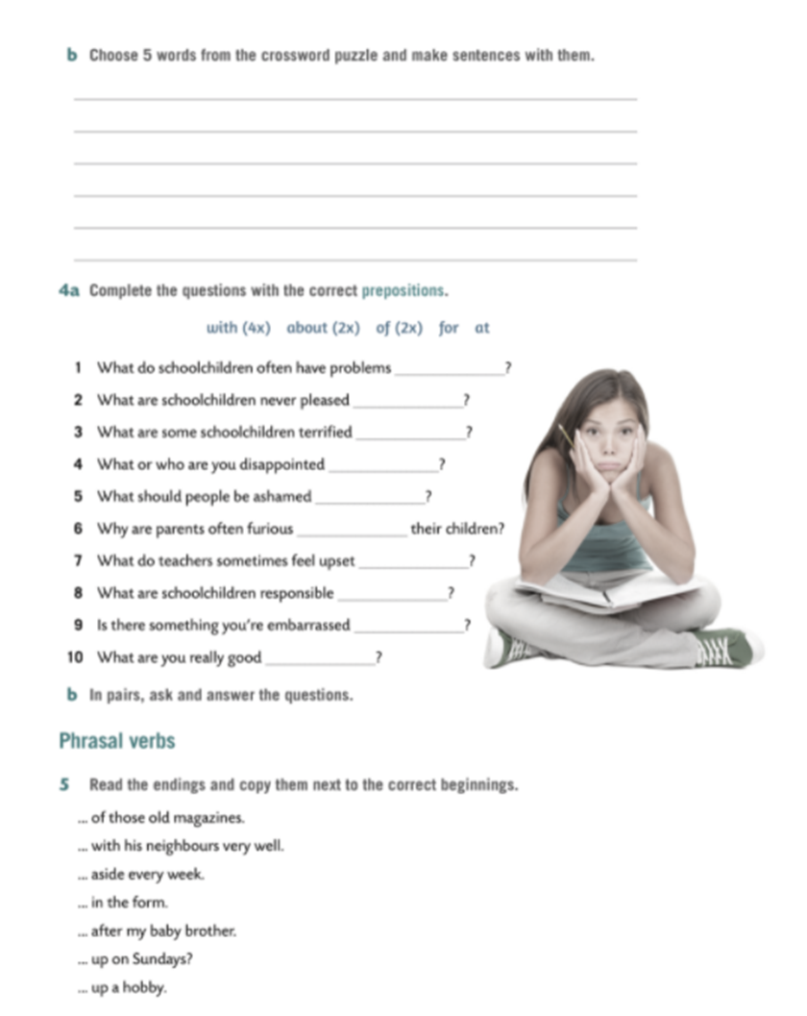
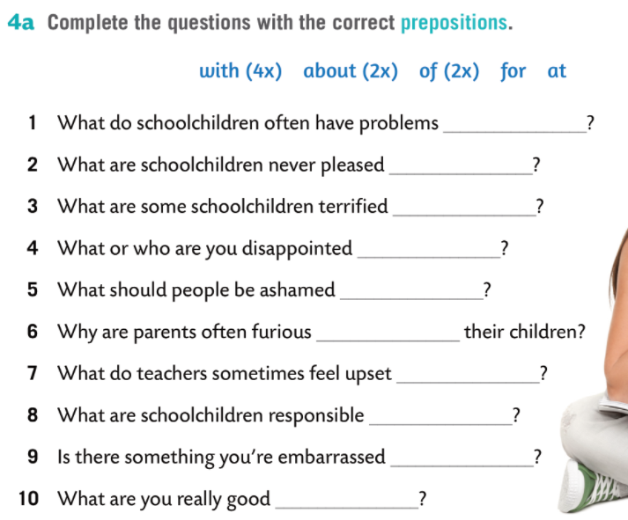
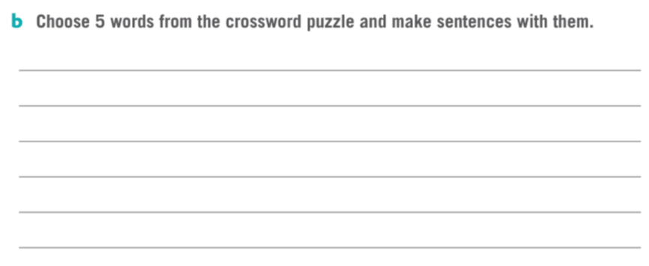

with
with
of
with
of
with
about
for
about
at

Slide 3
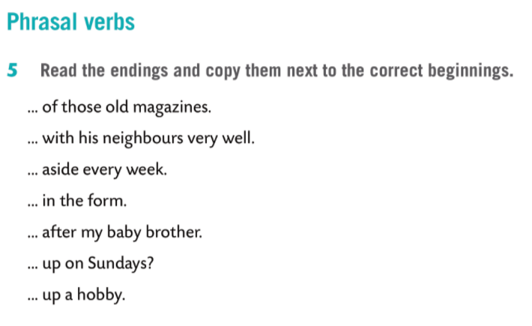
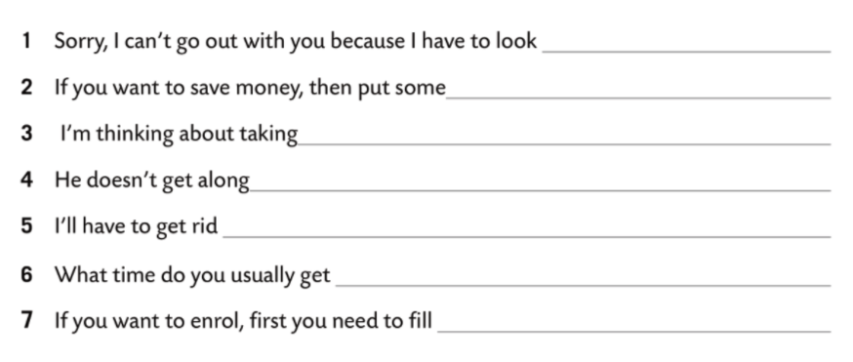




Slide 4
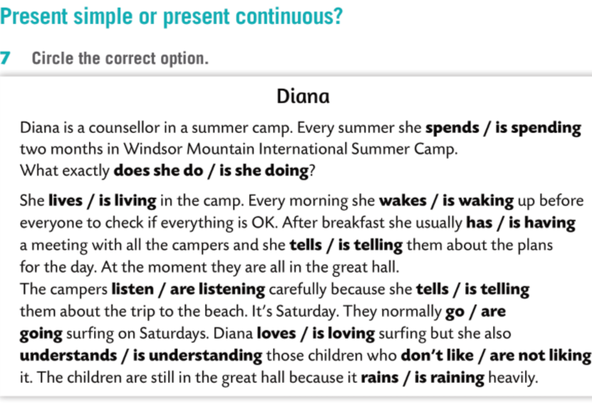
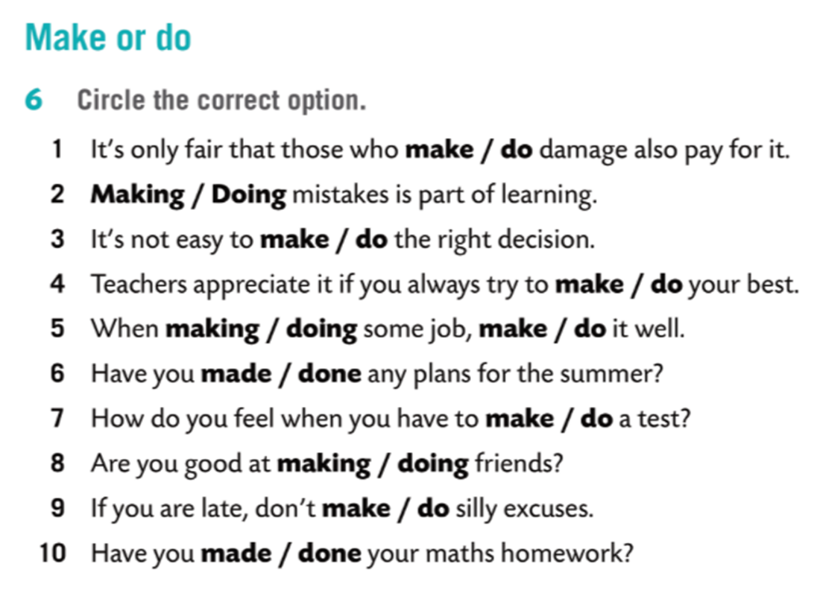

Slide 5
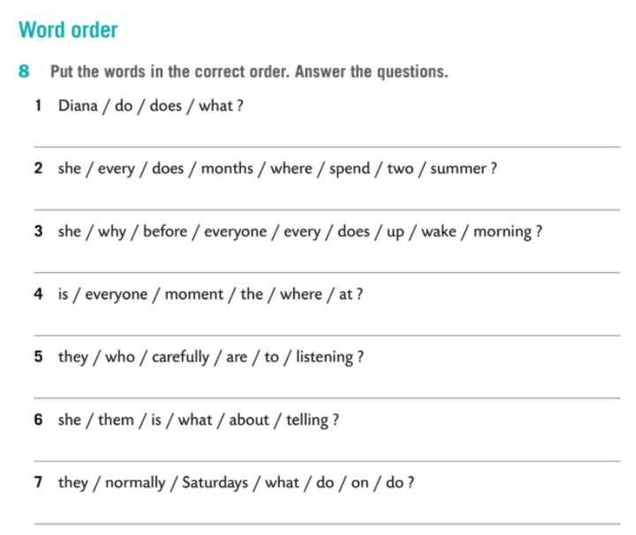
What does Diana do?
She’s a counsellor in a summer camp.
Where does she spend two months every summer?
In Windsor Mountain International Summer Camp.
Why does she wake up before everyone every morning?
To check if everything is OK.
Where is everyone at the moment?
In the great hall.
Who are they listening to carefully?
To Diana.
What is she telling them about?
About the plans for the day.
What do they normally do on Saturdays?
Go caving.

Slide 6
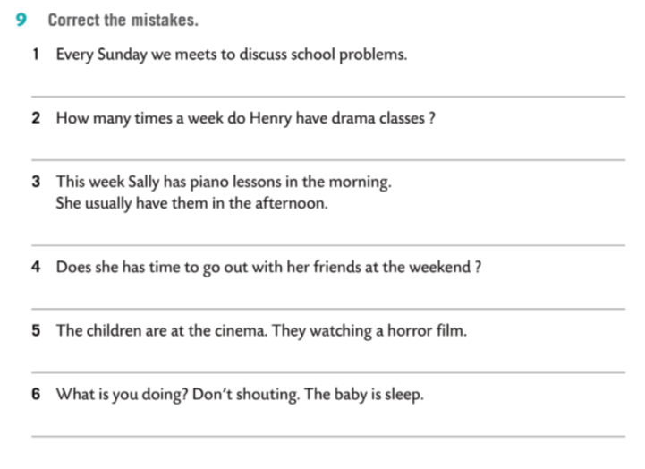
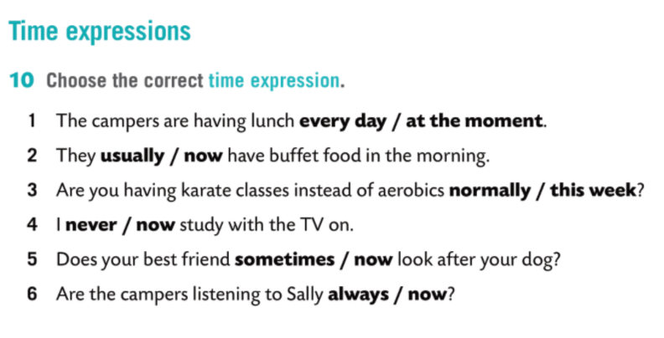
Every Sunday we meet to discuss school problems.
How many times a week does Henry have drama classes?
This week Sally is having piano lessons in the morning. She usually has them in the afternoon.
Does she have time to go out with friends at the weekend?
They are watching a horror film.
What are you doing?

Slide 7
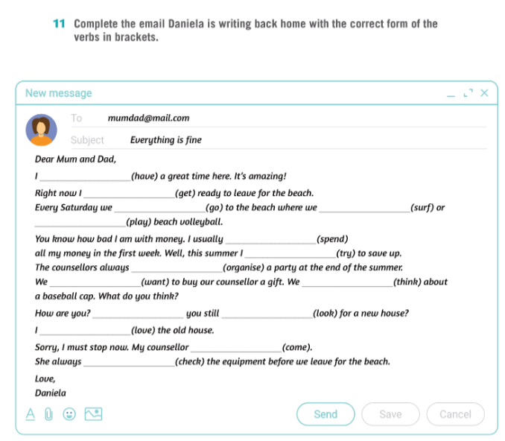
‘m having
‘m getting
go
surf
play
spend
‘m trying
organise
want
‘re thinking
Are
looking
love
is coming
checks

